Slide 1

Customer Data Science
Stand-up Updates
March 31, 2017

Slide 2




Key updates
BRFS Discount Sensitivity model
Time to Next Purchase Models BR
Time to Next Purchase Models GP
Discount Sensitivity Models & Analysis BR
Product Recommendation Engine – Site Testing
Gap Inc Confidential – Do Not Distribute or Copy Without Authorization

Slide 3
BR US discount sensitivity model
MARCH 2017
PLATFORM ANALYTICS

Slide 4
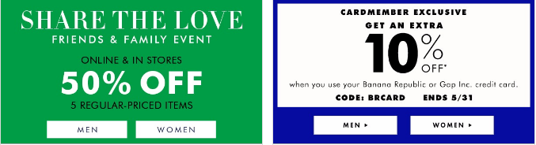

BACKGROUND
Objective:
Every year company shells out billions of $ in various discounts offered.
Not all Customers have affinity towards discounts to make a purchase.
This creates an opportunity to improve margin by offering relevant discounts to customers based on how discount sensitive they are.
The whole exercise will help in:
Increasing Revenue
Saving Cost
Definitions:
Response: customers taking above 35% of gross sales as discounts in an year
Response score: Probability of a customer to search discount above 35% to make purchase
Historical behavior
Response Window
Training
Transactions & Browse Data
Jan2015-Dec2015
Purchase Data
Jan2016-Dec2016
Validation
Transactions & Browse Data
Jul’14-Jun’15 and Feb’14-Jan’15
Purchase Data
Jul’15-Jun’16 and Feb’15-Jan’16
Algorithms | Library
Ensemble Leaners | xgboost, ada, adabag, gbm, randomForest
Support Vector Machines | kernlab
Logistic Regression
Deep Learning | mxnet, h2o, tensorflow, darch, scikit-learn
Data preparation
Exploratory Analysis
Scaling and Outlier Treatment
Dataset Size involved : 4.7M (Customer Keys), Response – 20.2%
Model Execution and Testing
Model Evaluation and Validation
Model Training

Slide 5
PREDICTORS AND RELATIVE IMPORTANCE

Slide 6
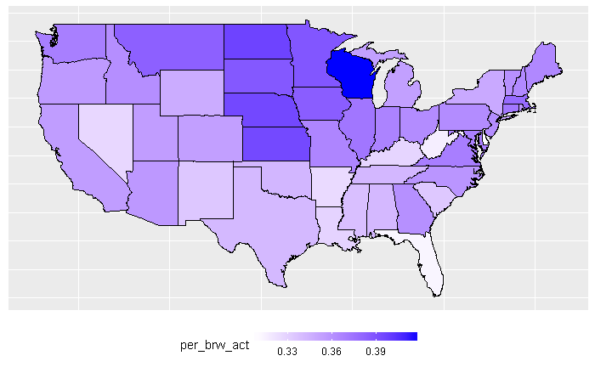
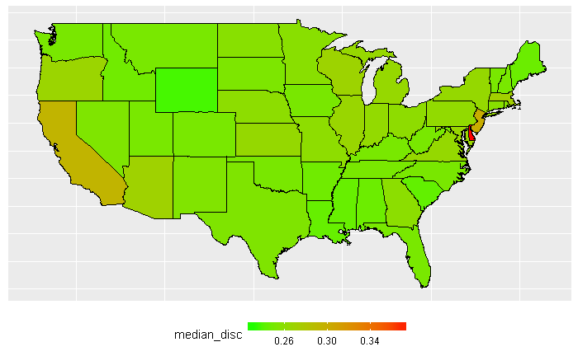
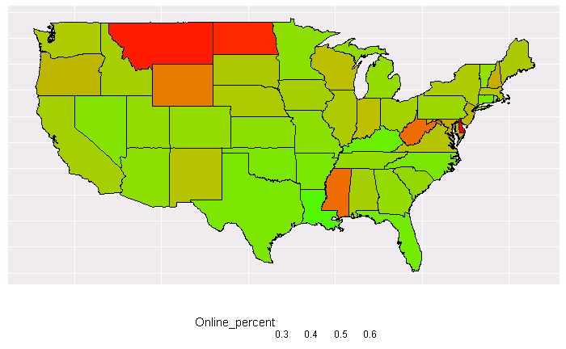
INTERESTING FACTS ABOUT DISCOUNT TAKEN
There Discount sensitive customers are also most likely online active customers
Browse active and % online sales are same in those sates.
Geography wise they follow the same pattern.

Slide 7
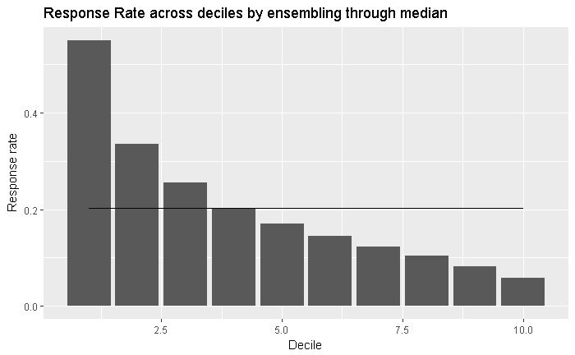
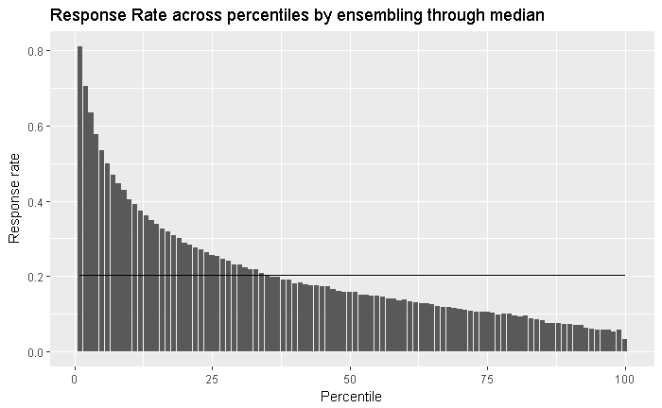
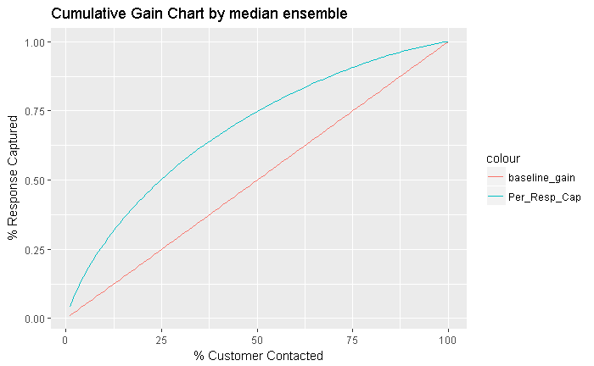
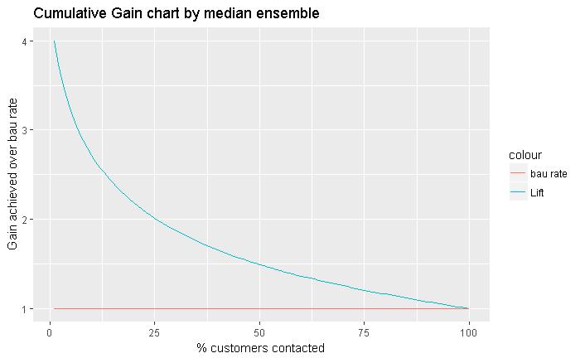
MODEL RESULTS - VALIDATIONS JUL 15-JUN 16
Decile | Customers | Number of Responder | Cum Responders | Response Rate | Response Gain | Cumulative Response Rate | Cumulative Lift
1 | 472,243 | 260,026 | 260,026 | 55.1% | 27.2% | 55.1% | 2.72
2 | 472,244 | 158,415 | 418,441 | 33.5% | 43.7% | 44.3% | 2.19
3 | 472,243 | 120,468 | 538,909 | 25.5% | 56.3% | 38.0% | 1.88
4 | 472,244 | 95,893 | 634,802 | 20.3% | 66.3% | 33.6% | 1.66
5 | 472,244 | 80,267 | 715,069 | 17.0% | 74.7% | 30.3% | 1.49
6 | 472,243 | 68,752 | 783,821 | 14.6% | 81.9% | 27.7% | 1.37
7 | 472,244 | 58,311 | 842,132 | 12.3% | 88.0% | 25.5% | 1.26
8 | 472,243 | 48,850 | 890,982 | 10.3% | 93.1% | 23.6% | 1.16
9 | 472,244 | 38,555 | 929,537 | 8.2% | 97.1% | 21.9% | 1.08
10 | 472,244 | 27,395 | 956,932 | 5.8% | 100.0% | 20.3% | 1.00
Model Summary:
Among many models , GBM algorithm was picked based on model performance.
Out of 2000 GBM models, best 20 have been picked and data is scored . Ensemble of median score was taken as final probability which was used for validation
Response Rate across deciles by median score from 20 models
Response Rate across percentiles by median score from 20 models
Cum Gains using median score from 20 models
Cum Lift using median score from 20 models

Slide 8
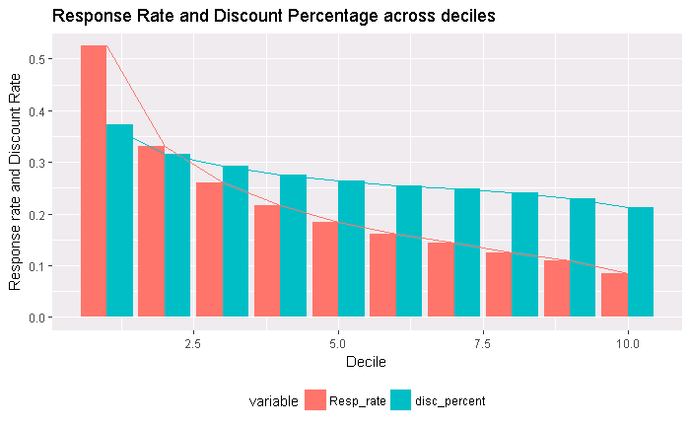
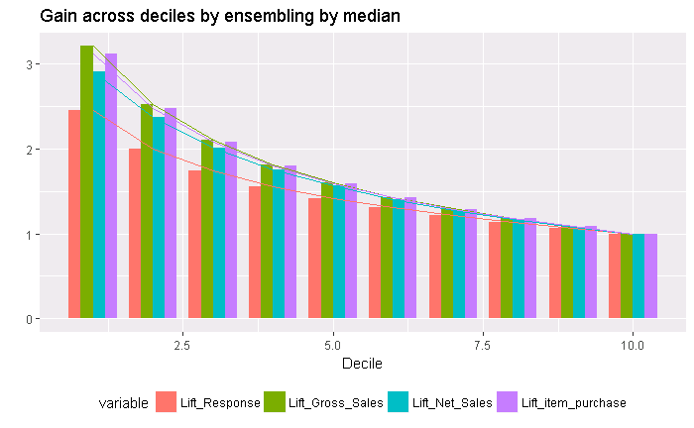
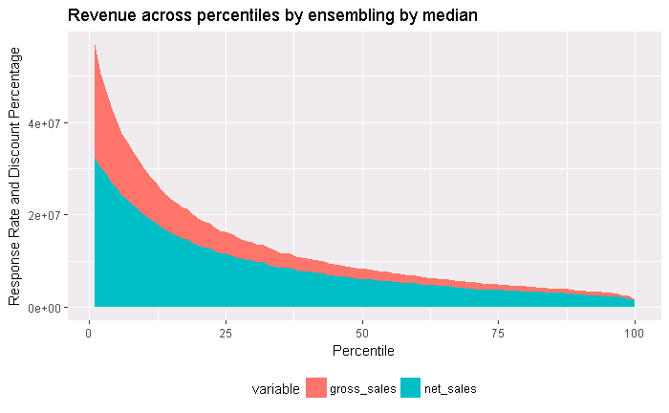
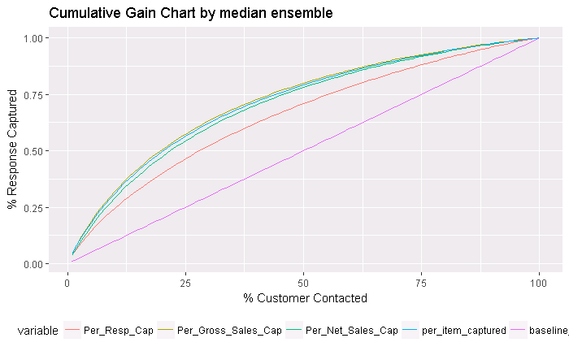
MODEL RESULTS - VALIDATIONS FEB14-JAN15
Model Summary:
Model is performing on all necessary business metrics
Waterfall is maintained across customer decile

Slide 9
BR US Time to Next Purchase Prediction Model
MARCH 2017
PLATFORM ANALYTICS

Slide 10


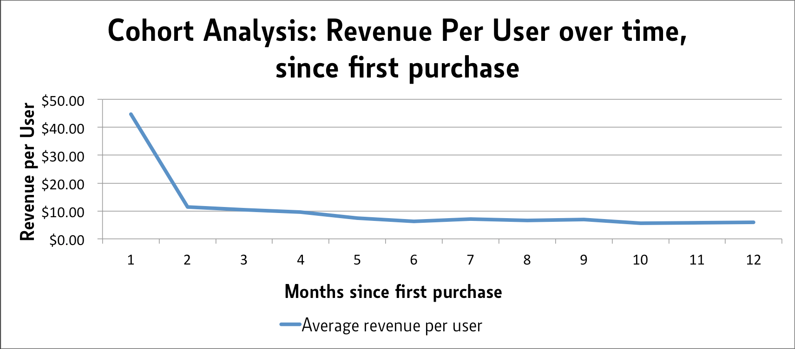
BACKGROUND
Next Purchase Prediction Model enables answering Questions Like
When is the customer most likely to make a purchase ?
When should a customer be targeted on a longer time scale.
Who is most likely to make a purchase at a given time ?
Should the customer be targeted in our next campaign.
Explaining Tradeoffs between various customer cohorts ?
Who is a better target?
A more frequent buyer or a less frequent buyer who hasn’t bought in a long time
Scope: BR US
Algorithm: Bayesian Model
Data: Yearly Transaction Data
Platforms & Packages: Hive, Python
Training Window
Validation Window
Purchase
06/1/2015- 06/30/2016
Purchase Data
7/1/2016- 12/31/2016
Data preparation
Exploratory Analysis
Scaling and Outlier Treatment
Training Dataset : 3000,000 master-keys
Testing Dataset : 1000,000 master-keys
Model Execution and Testing
Model Evaluation and Validation
Model Training

Slide 11
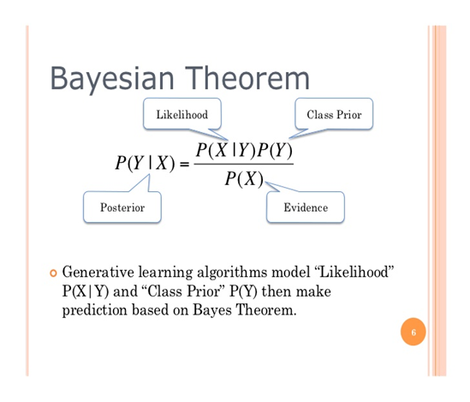
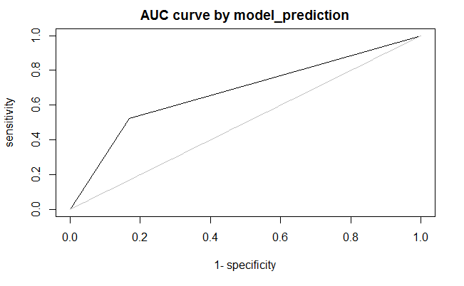
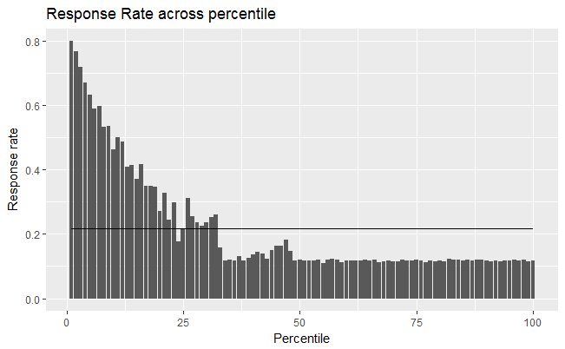
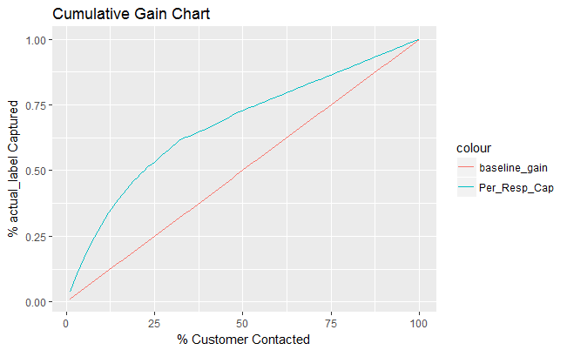
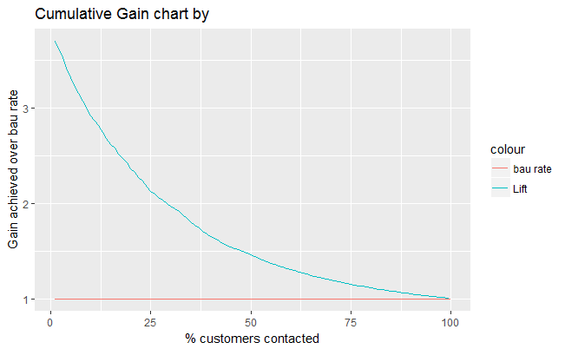
Bayesian Model
Using the Joint Distribution of features.
Uses Bayes Theorem to integrate population level and customer level information.
P(Y) – Prior Probability of Repurchase at various times.
Population Level probability
P(X|Y) – Likelihood of a Feature at Various Repurchase Times
Learnt From the Training Data (Customer level purchase data )
P(Y|X) = P(X|Y) * P(Y)/P(X)
Model Features
Purchase Count in a calendar year.
Variance of Inter Purchase times.
Time in weeks since last purchase.
Distance from beginning /end of month of Latest Purchase.
Time Elapsed Since Last Transaction vs Average time between Transactions.
Model Usage
The time T :- Maximum of the Repurchase Probability Across time is considered as the Model Prediction for Next Purchase Time.
Model Metrics
1 Month – 68.23% AUC
3 Months – 67.80% AUC

